Slide 1
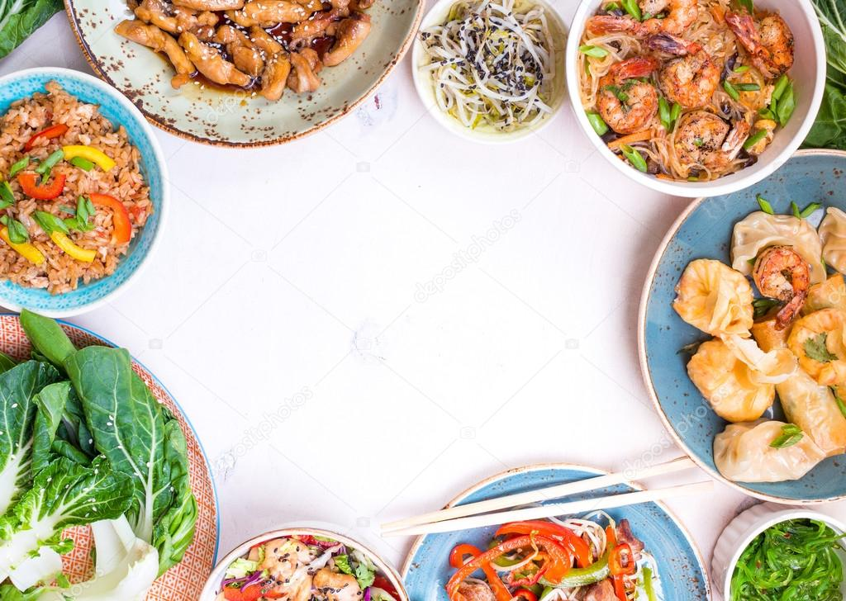
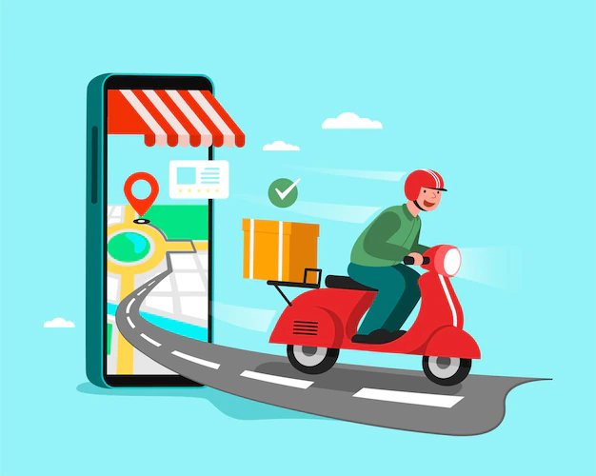
Tasty Treks
An online Food Delivery System

Slide 2
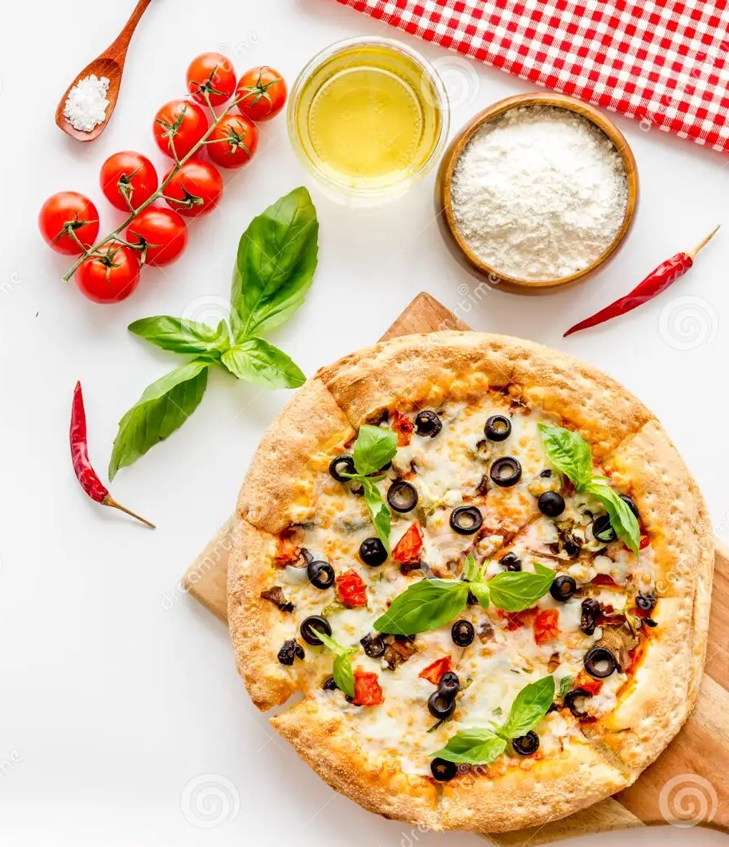
Presented By:-
Rajan Sharma 2567471
Saptarshi Paul 2567736
Shaik Raheem 2567212
Sulam Omprakash 2567946
Suragani Satish Kumar 2567088
Vaishnavi S 2569284
Vijayakumar Kumaravelu 2567582
Arpita Ambastha 2568411

Slide 3
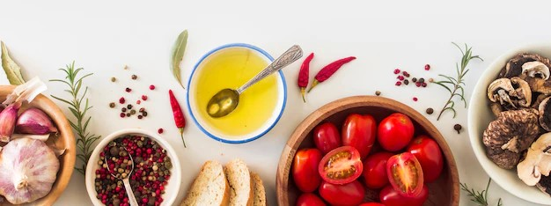
Table of Content:-
Introduction to the App
Architecture Overview
Technologies Used
Features
Advantages
Results
Conclusion

Slide 4
Introduction to the App:-
Tasty Treks is an online food delivery web application for ordering food items of different cuisines from any restaurant.
Tasty Treks bridges the gap between restaurants and customers, making it possible for individuals to order their preferred dishes from any location.
Tasty Treks is a system offering user-friendly app that allows customers to browse a various range of restaurants and explore menus.

Slide 5
Technology Used
Front-End
HTML,CSS3 and Bootstrap4
TypeScript : Angular
Back-End
Spring Tool Suite
MySQL
Spring boot
Postman
TestNg and Selenium

Slide 6
Architecture Overview:-
Registration Management
Payment Management
Login Management
Online Food Delivery System
Product Management
Profile Management
Cart Management

Slide 7
Start
Flowchart:-
Tasty Trek
Admin
User
Reg
Login
Login
Reg
Admin Dashboard
User Dashboard
Yes
Yes
Add Products
View Menu
Manage User
Add to Cart
Update Products
Place/Cancel Order
Delete Products
Payment
delete
Logout
End

Slide 8
Features:-
User/Admin Registration Page.
User/Admin Login Page.
User/Admin Dashboard
Add Cart/View Cart.
Payment Gateway Page.

Slide 9
Working:-
Online food Delivery application is an online food delivery web application for ordering food items of different cuisines from any restaurant.
In this web application we have the admin dashboard and user dashboard
Admin Dashboard – In this we have a registration for admin then login of the admin portal , redirecting to the admin dashboard. We can add, update or delete food items from the product portal.
User dashboard allows registration, login, cart management, profile updates, and food exploration.
After selecting the food items user can make payment through our payment gateway method and get a order confirmation message.

Slide 10

Logo of the App

Slide 11
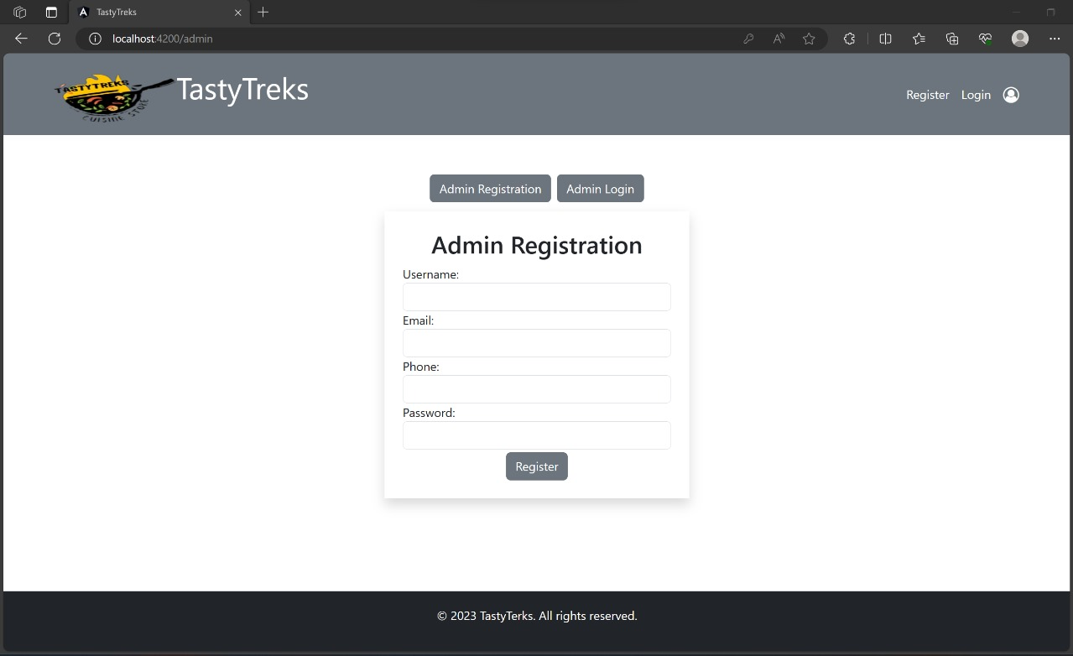
Results:-
1. Admin Registration

Slide 12
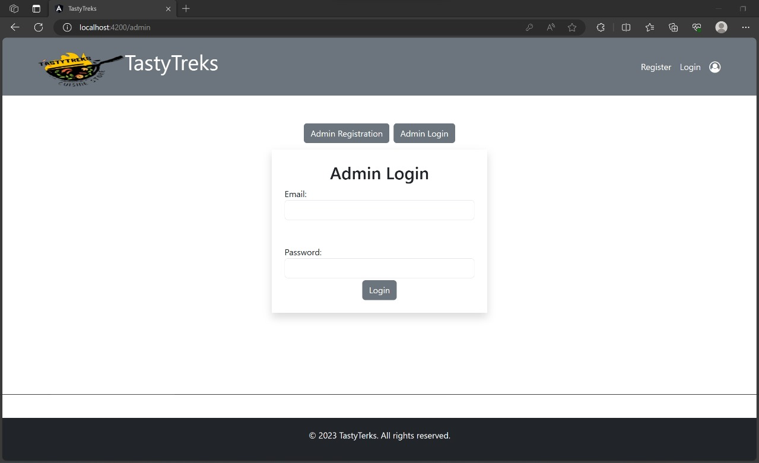
2. Admin Login

Slide 13
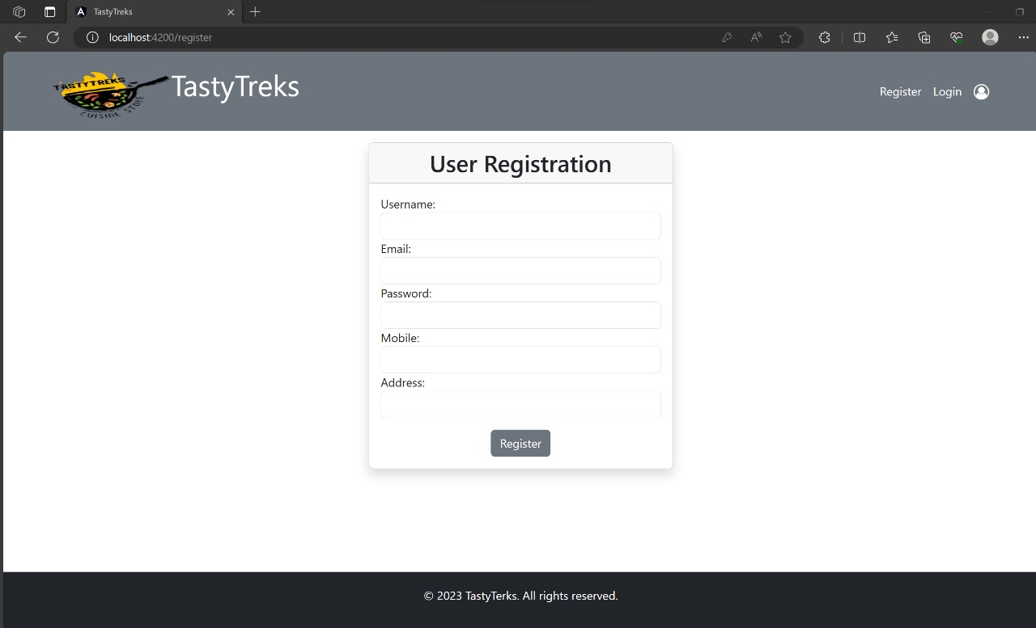
3. User Registration

Slide 14
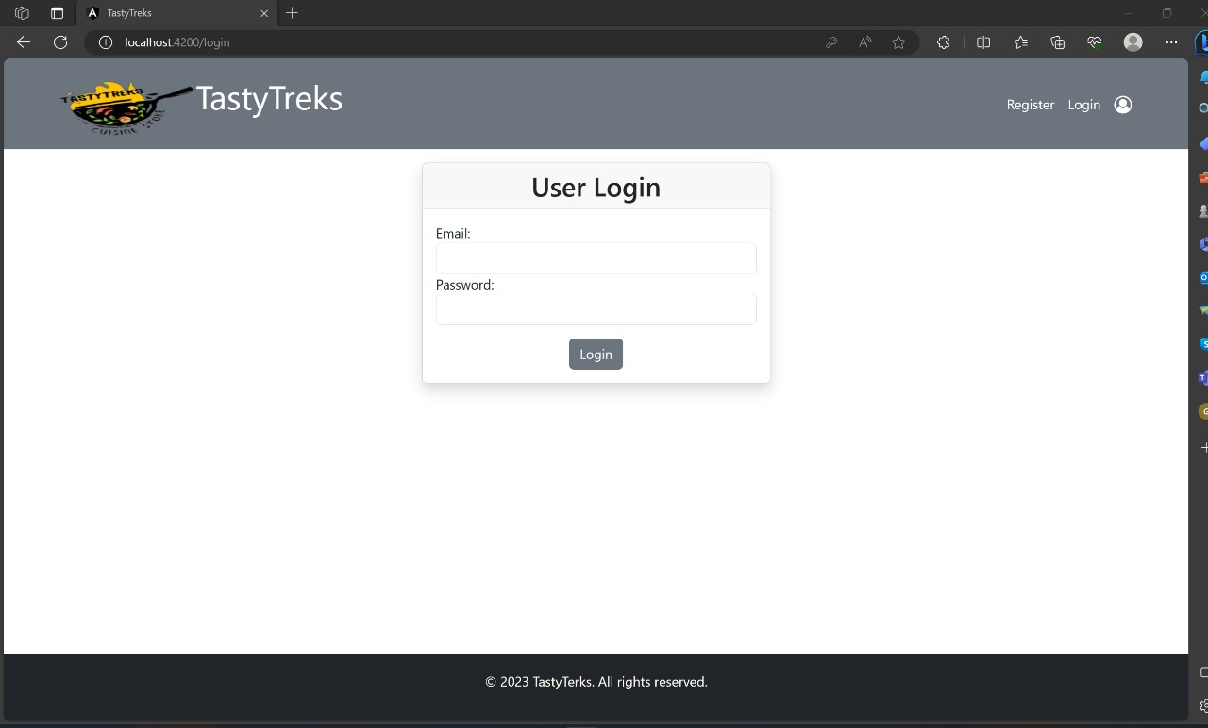
4. User Login

Slide 15
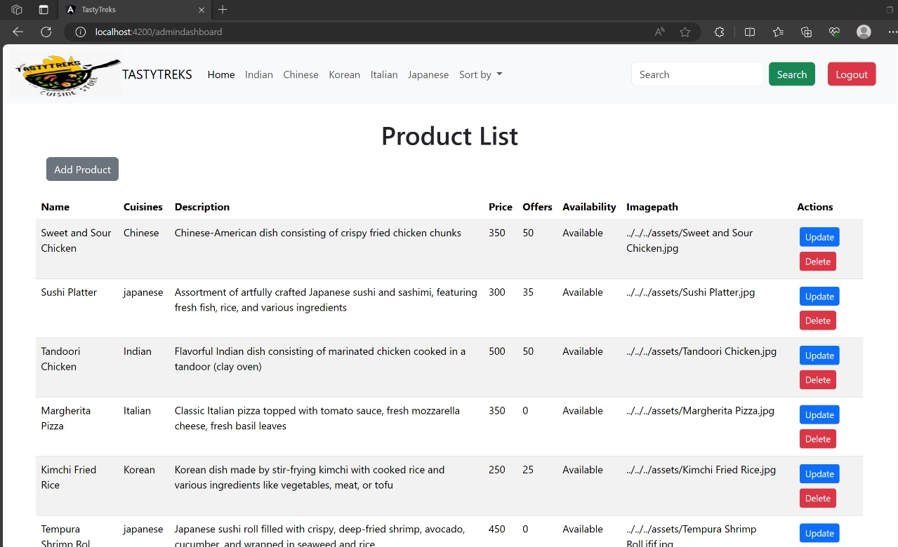
5. Admin Dashboard

Slide 16
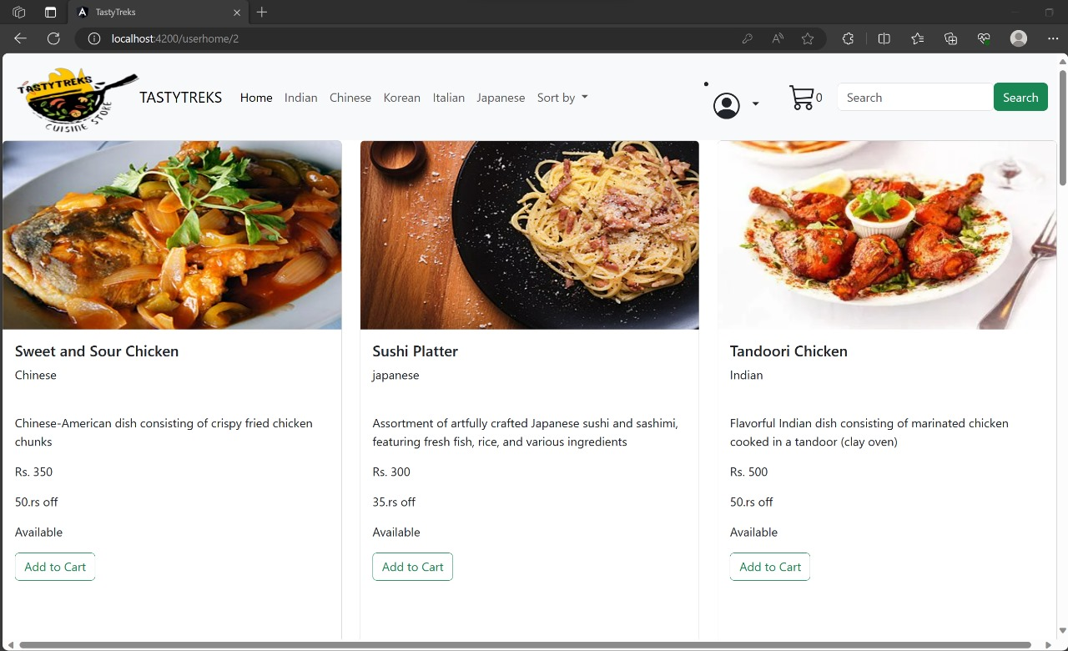
6. User Dashboard

Slide 17
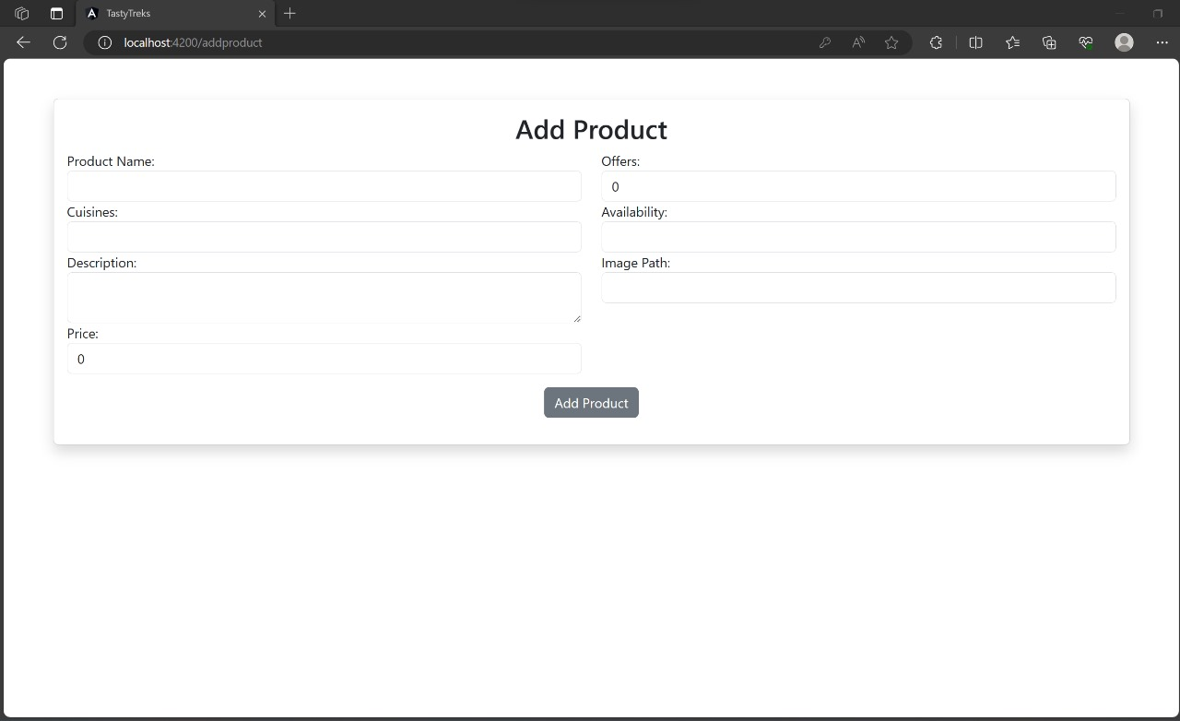
7. Add Product

Slide 18
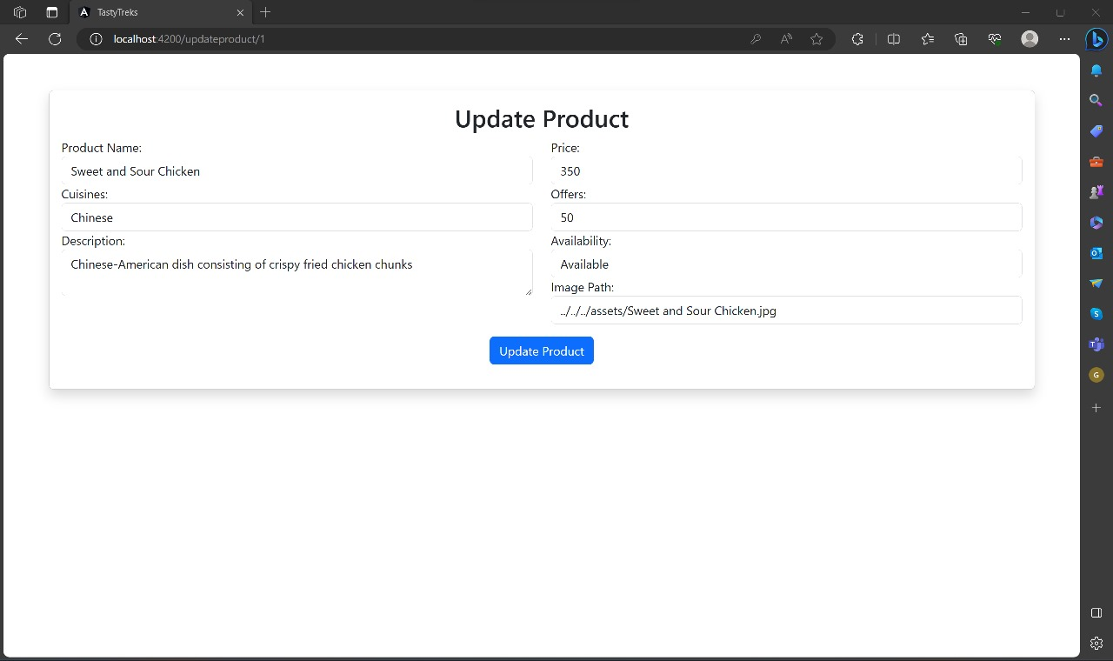
8. Update Product

Slide 19
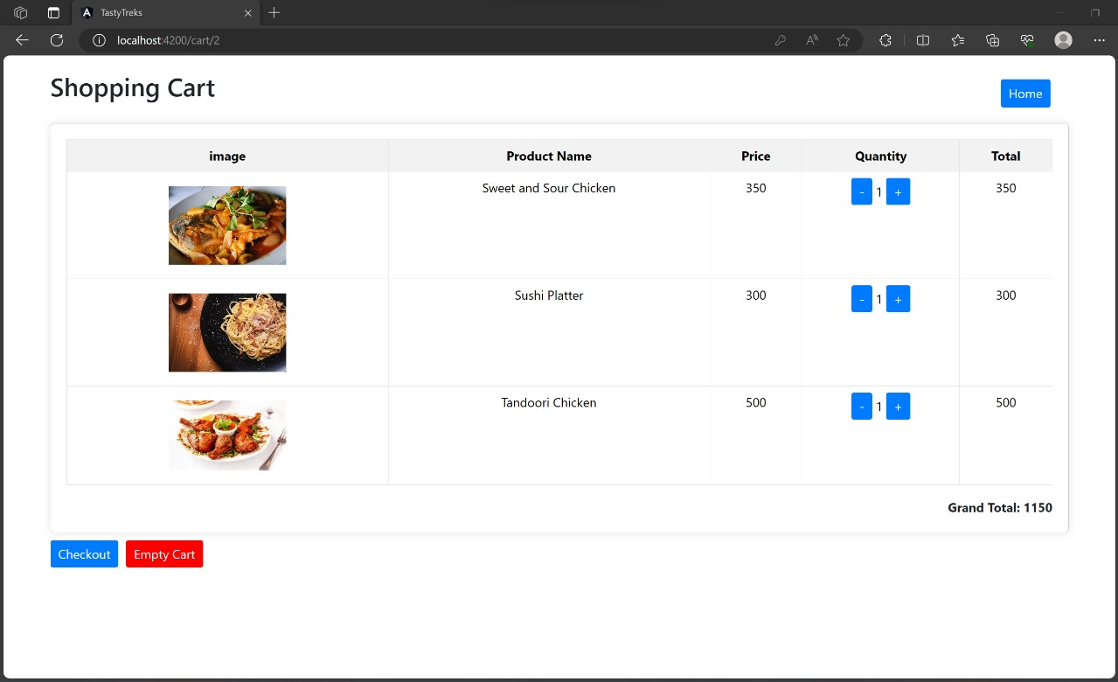
9. Shopping Cart

Slide 20
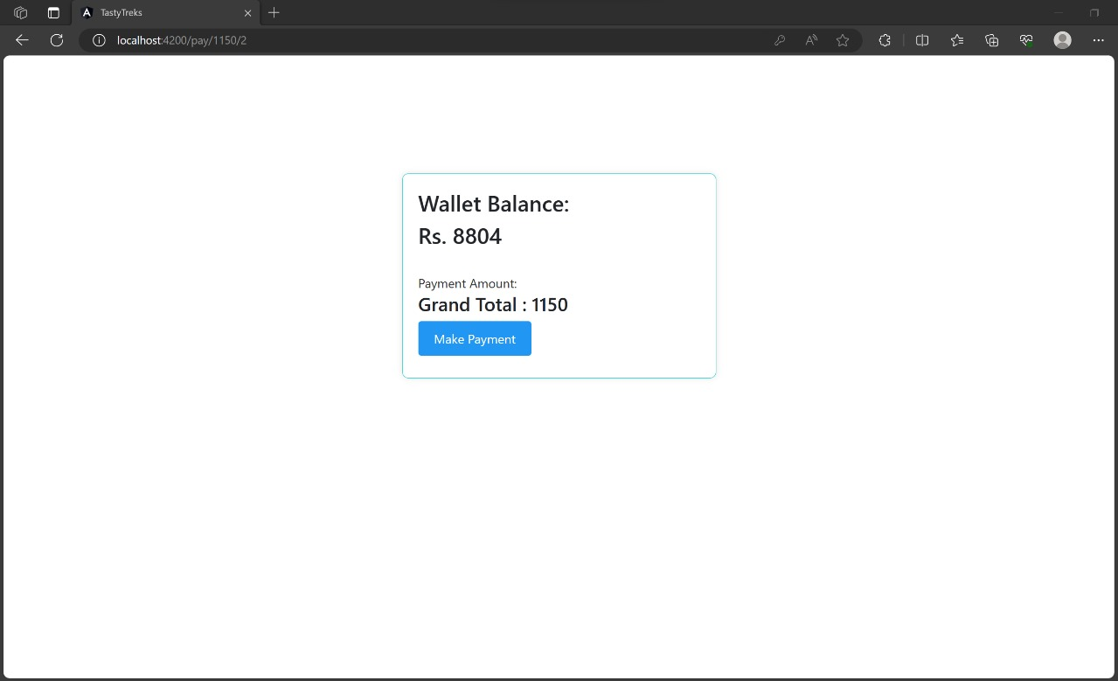
10. Payment Method

Slide 21
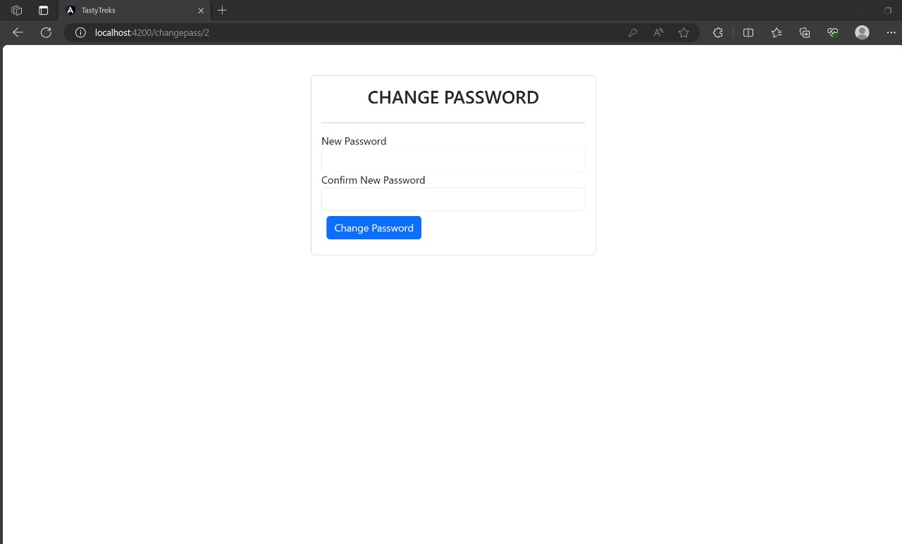
11. Change Password

Slide 22
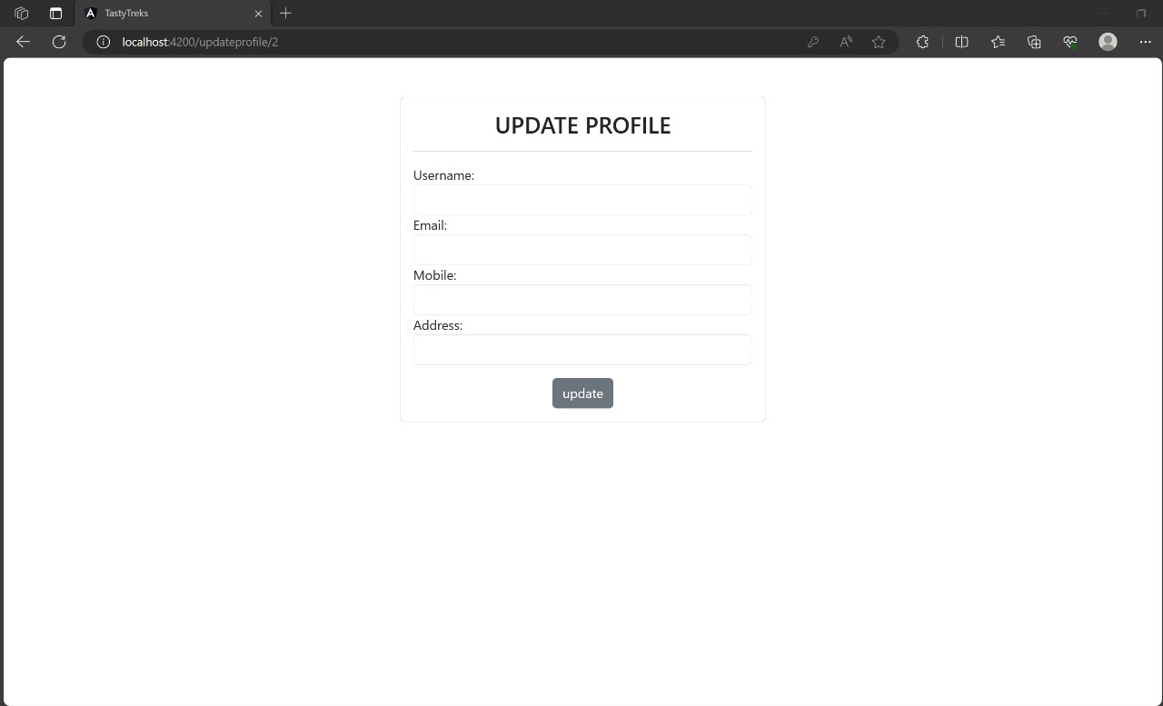
12. Update Profile

Slide 23
Advantages:-
User Friendly
Easy to use. ​It is completely secure.
​This system is easily compatible with most of the web browsers.
​Admin can access all the records .
Store the end-end data of Users & Admins.

Slide 24
Conclusion:-
Implementing this system in the organization reduces data entry, saves time, and offers instant, automated report generation.
It is designed to replace an existing manual record system thereby reducing time taken for calculations and for storing data.

Slide 25
